Slide 1
Data Engineering - Final
Part 1: Regression and Classification Analysis
1.1 Data Collection: Currency pairs (CPs) including EURUSD, EURCHF, EURCAN, GBPEUR, GBPUSD,
GBPCHF, GBPCAN, USDCHF, USDCAN, and USDJPY are selected for analysis. Real-time data is fetched
from Polygon for these pairs.
1.2 Regression: A regression model is built using the average mean price, volume, and other
statistical features among the base CPs. Additionally, correlations with EURUSD and BTC are used as
new features. This model aims to predict future price movements based on historical data.
1.3 Classification: GBPUSD and USDJPY are chosen for classification analysis. Each currency pair is
classified as FORECASTABLE (F), NON-FORECASTABLE (N), or UNDEFINED (U) based on the RMSE
values predicted. This classification helps in identifying pairs suitable for trading strategies

Slide 2
Part - 2
Part 2: Long/Short Trading Strategy
2.1 Selection of Long/Short CPs: The slope of a 20-point univariable time series regression is used to
select Long and Short currency pairs. This methodology helps in identifying pairs with favourable
trends for trading.
2.2 Implementation of L/S Strategy: The L/S strategy is initiated at hour #5 and adjusted at
subsequent hours, considering the ratio between USDJPY and GBPUSD. Trading positions are closed
at hour #8.
2.3 Profit/Loss Calculation: Accounting is done to compute the Profit/Loss (P/L) of the L/S strategy
based on the trading steps. A standard investment amount of $100 is assumed for each step.

Slide 3
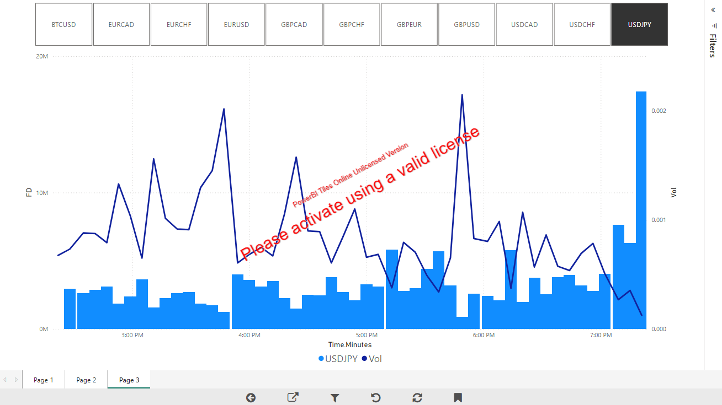
Power BI Explanation

